Slide 1
PCS110: Data Science Foundation
Dr. Seema Bawa
Professor, Computer Science and Engineering,
Professor In Charge, Nava Nalanda Central Library
Former Dean (Student Affairs),
Former Head, Computer Science and Engineering Department

Slide 2
Data Science: Introduction
Big data is a blanket term
for any collection of data sets so large or complex that it becomes difficult to process them using traditional data management techniques such as, for example, the RDBMS (relational database management systems).
Data science involves using methods to analyze massive amounts of data and extract the knowledge it contains.
Data scientist is someone who extracts insights from messy data.

Slide 3
Data science is an evolutionary extension of statistics capable of dealing with the massive amounts of data produced today.
Many companies use data science to offer customers a better user experience, as well as to cross-sell, up-sell, and personalize their offerings.
A good example of this is Google AdSense, which collects data from internet users so relevant commercial messages can be matched to the person browsing the internet.

Slide 4
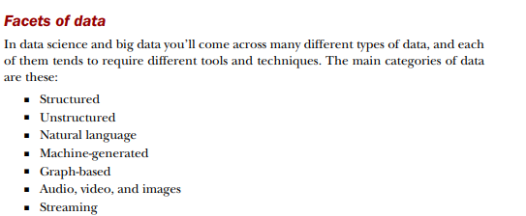

Slide 5
Record data
The most basic form of data is record data that has no explicit relationship among records or data fields, and every record (object) has the same set of attributes.
Record data is usually stored either in flat files or in relational databases.

Slide 6
Temporal Data
A temporal database stores data relating to time instances. It offers temporal data types and stores information relating to past, present and future time.
Spatiotemporal, or spatial temporal, is used in data analysis when data is collected across both space and time
It describes a phenomenon in a certain location and time
for example, shipping movements across a geographic area over time

Slide 7
A temporal database stores data relating to time whether past, present or future.
It can establish at what times certain entries are accurate.
Temporal data is of following types:
Continuous
Discrete
Stepwise-constant
Period based

Slide 8
Spatial Data
Spatial data is any type of data that directly or indirectly references a specific geographical area or location.
There are several spatial data types, but the two primary kinds of spatial data are geometric data and geographic data.
Geometric data is a spatial data type that is mapped on a two-dimensional flat surface. An example is the geometric data in floor plans. Google Maps is an application that uses geometric data to provide accurate direction. In fact, it is one of the simplest examples of spatial data in action.
Geographic data is information mapped around a sphere. Most often, the sphere is planet earth. Geographic data highlights the latitude and longitude relationships to a specific object or location. A familiar example of geographic data is a global positioning system.

Slide 9
Graph data
Graph analytics is another commonly used term, and it refers specifically to the process of analyzing data in a graph format using data points as nodes and relationships as edges.
There are two popular models of graph databases: Property graphs and RDF (Resource Description Framework) graphs.
The Property graph focuses on analytics and querying, while the RDF graph emphasizes data integration.
Both types of graphs consist of a collection of points (vertices) and the connections between those points (edges).

Slide 10
Structured Data
Data that depends on a (fix) data model and resides in a fixed field (within a record).
Easy to store in tables (within databases or Excel files)
Some structured data that might give us a hard time storing it in a traditional relational database.
Hierarchical data such as a family tree is one such example.

Slide 11
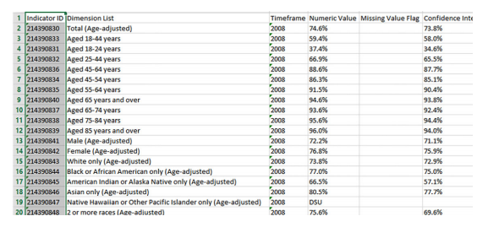

Slide 12
Semi-structured Data
Data which does not conforms to a data model but (still) has some structure.
Lacks a fixed or rigid schema.
It is the data that does not reside in a rational database yet that have some organisational properties that make it easier to analyze.
With some process, we can store them in the relational database.
Characteristics of semi-structured Data:
Data does not conforms to a data model but has some structure.
Data can not be stored in the form of rows and columns as in Databases
Semi-structured data contains tags and elements (Metadata) which is used to group data and describe how the data is stored

Slide 13
Semi-structured Data
Similar entities are grouped together and organised in a hierarchy
Entities in the same group may or may not have the same attributes or properties
Does not contains sufficient metadata which makes automation and management of data difficult
Size and type of the same attributes in a group may differ
Due to lack of a well defined structure, it can not used by computer programs easily

Slide 14
Sources of semi-structured Data:
E-mails
XML and other markup languages
Binary executables
TCP/IP packets
Zipped files
Integration of data from different sources
Web pages

Slide 15
Advantages of Semi-structured Data:
The data is not constrained by a fixed schema
Flexible i.e Schema can be easily changed.
Data is portable
It is possible to view structured data as semi-structured data
Its supports users who can not express their need in SQL
It can deal easily with the heterogeneity of sources.

Slide 16
Disadvantages of Semi-structured data
Lack of fixed, rigid schema make it difficult in storage of the data
Interpreting the relationship between data is difficult as there is no separation of the schema and the data.
Queries are less efficient as compared to structured data.

Slide 17
Unstructured Data
Unstructured data is data that isn’t easy to fit into a data model because the content is context-specific or varying.
Text and multimedia are two common types of unstructured content.
From 80 to 90 percent of data generated and collected by organizations, is unstructured
Unstructured data can be stored in a number of ways: in applications, NoSQL (non-relational) databases, data lakes, and data warehouses.
Platforms like MongoDB Atlas are especially well suited for housing, managing, and using unstructured data.

Slide 18
What is unstructured data used for?
Analyzing communications for regulatory compliance
Tracking and analyzing customer social media conversations and interactions
Gaining reliable insights into widespread customer behavior and preferences
Raw and Processed Data, Processed Data = Information.

